Slide 1
UE19CS353 – Object Oriented Analysis and Design with Java (Mini Project) team-6 Semester-6 section ‘b’
Seat reservation system
Gourav aravinda -----------------------------------PES2UG19CS130
Dev darshan j -----------------------------------------pes2ug19cs108
Bhargav Narayanan p----------------------------pes2ug19cs088

Slide 2

PROJECT DESCRIPTION
(GitHub-link:- https://github.com/GouravAravinda/Seat-Reservation-System )
The main objective of our project is to provide an easy and user friendly interface that enables our users, clients to reserve seats and purchase tickets to trains travelling from a certain station to the user’s desired destination.
The project insists on providing a hassle-free experience to our clients while they reserve seats in the trains they desire.

Slide 3
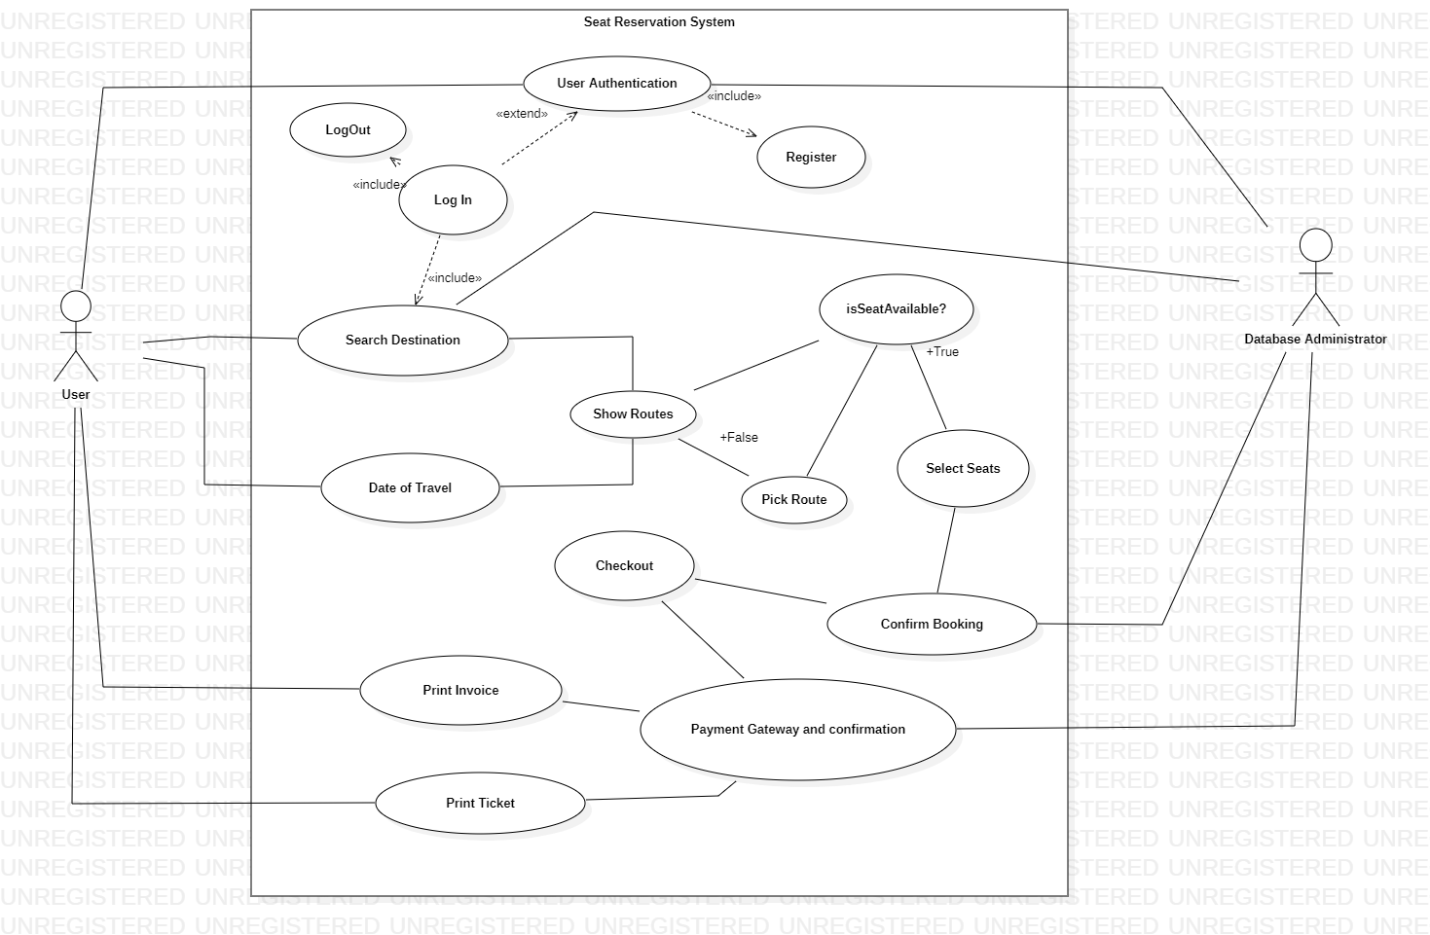
Analysis and design models
Use Case Diagram:-

Slide 4
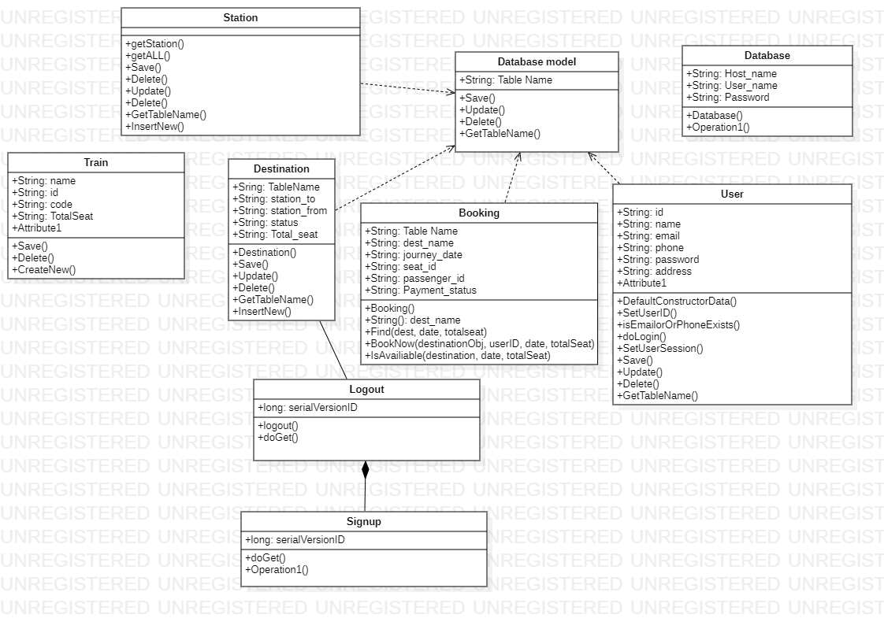
Class Diagram:-

Slide 5
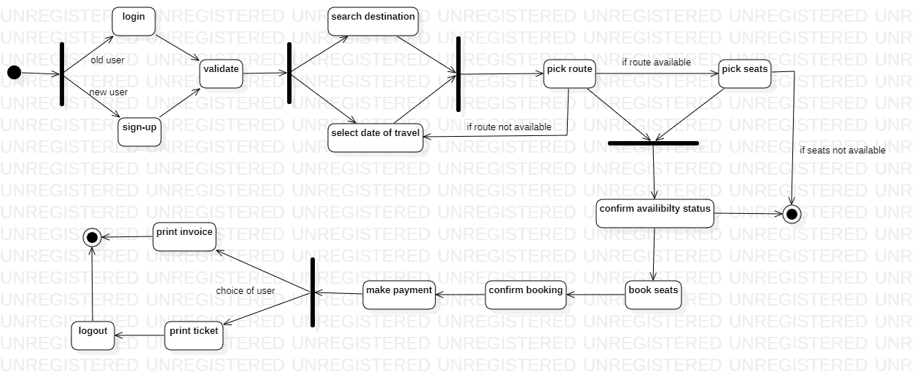
User State Chart Diagram:

Slide 6
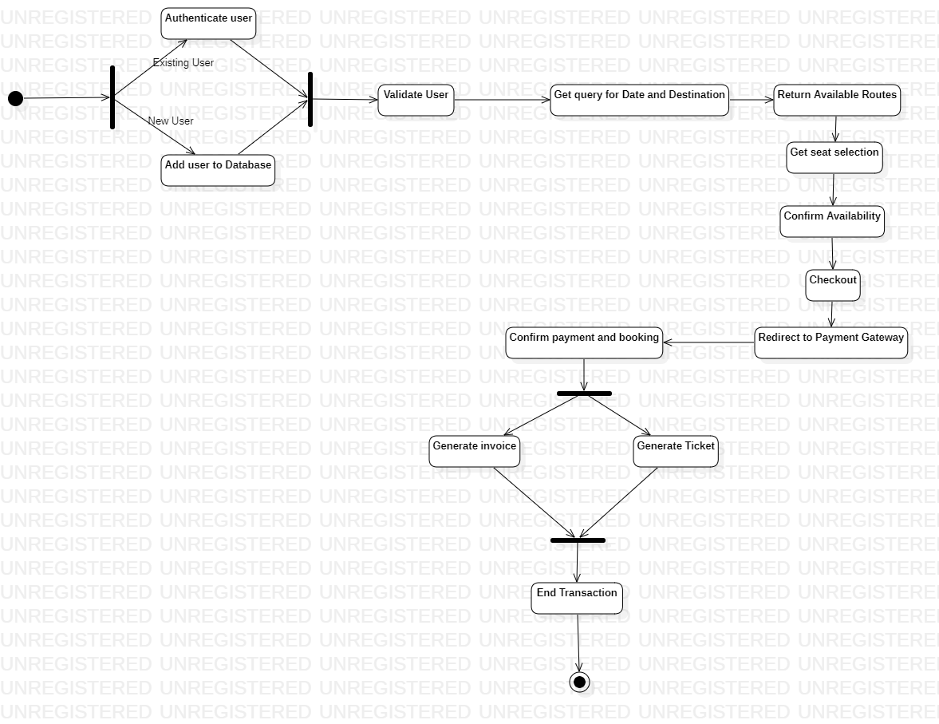
Database State Chart Diagram:-

Slide 7
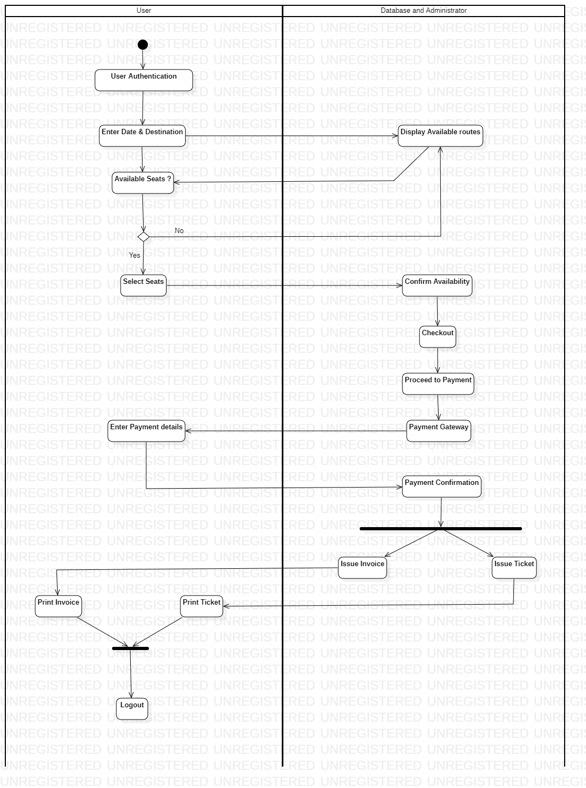
Activity Diagram:-

Slide 8
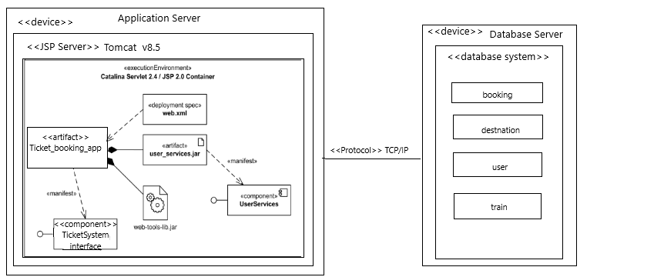
Deployment diagram:-

Slide 9






TOOLS AND FRAMEWORK USED
Tools used:-
Eclipse IDE for J2EE projects
Apache Tomcat Server v8.5
MySQL Workbench
2. Frameworks:-
JSP Servlet
JRE
J2EE services
JDBC driver
SQL for Databases

Slide 10
DESIGN PATTERNS
1. MVC :- (Model View Controller)
Generally all implementations are based on MVC architectural pattern.
Model - represents the data & Business logic layers
View - represents the UI, every UI interaction is sent to the controller
Controller - represents the connection between the View & Model
The main purpose is to separate the functioning between the UI implementation and the application logic.

Slide 11
DESIGN PATTERNS
2. Builder Pattern
The Builder pattern, which is one of the 23 Gang of Four Design (GoF) patterns, is a creational design pattern that lets you construct complex objects step by step. It allows you to produce different types and representations of a product using the same construction code.
This Pattern is used in our Project to help generate tickets to different train journeys for the users. Every ticket generated will compose of the same constituents but for each ticket information varies.

Slide 12
DESIGN PATTERNS
3. Façade
Facade is a part of Gang of Four design pattern and it is categorized under Structural design patterns. In Java, the interface JDBC can be called a facade because, we as users or clients create connection using the “java.sql.Connection” interface, the implementation of which we are not concerned about. The implementation is left to the vendor of driver.
A facade is an object that serves as a front-facing interface masking more complex underlying or structural code.
In our project we have used this design pattern to project to the users, the information about the train routes , without having to disclose the internal complexities within the code to the user.

Slide 13
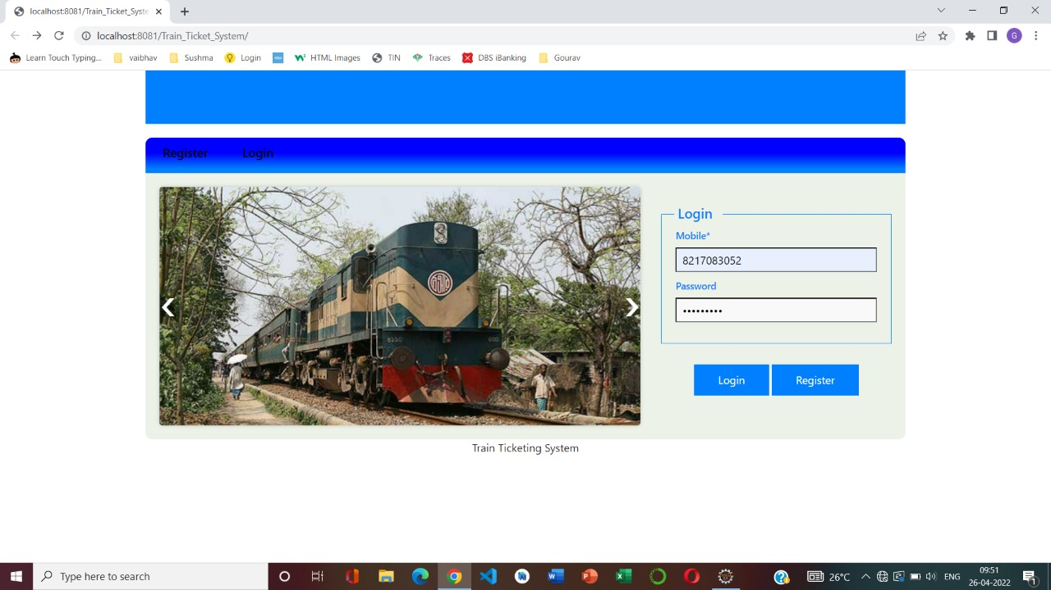
APPLICATION SCREENSHOTS

Slide 14
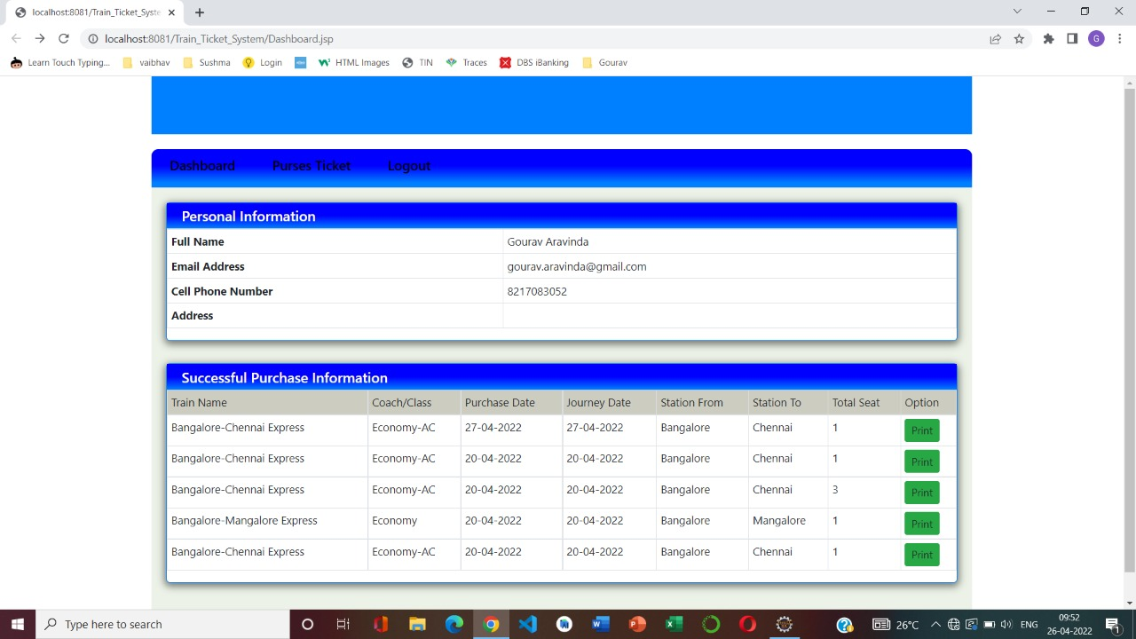
APPLICATION SCREENSHOTS

Slide 15
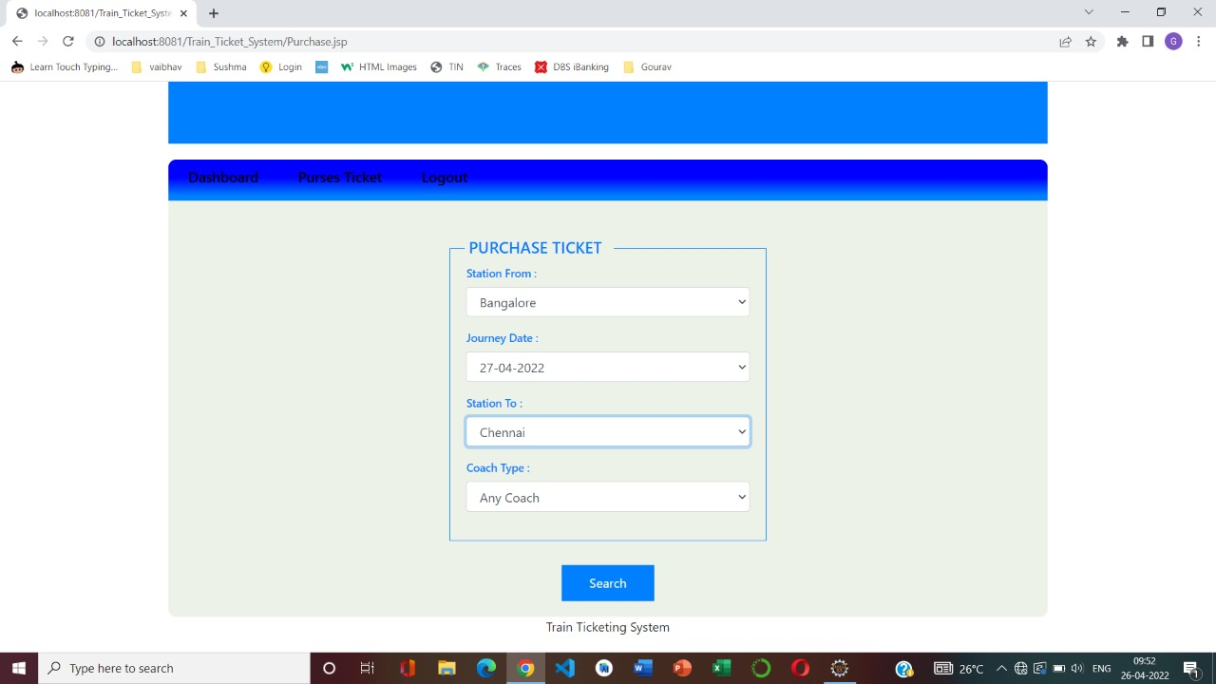
APPLICATION SCREENSHOTS

Slide 16
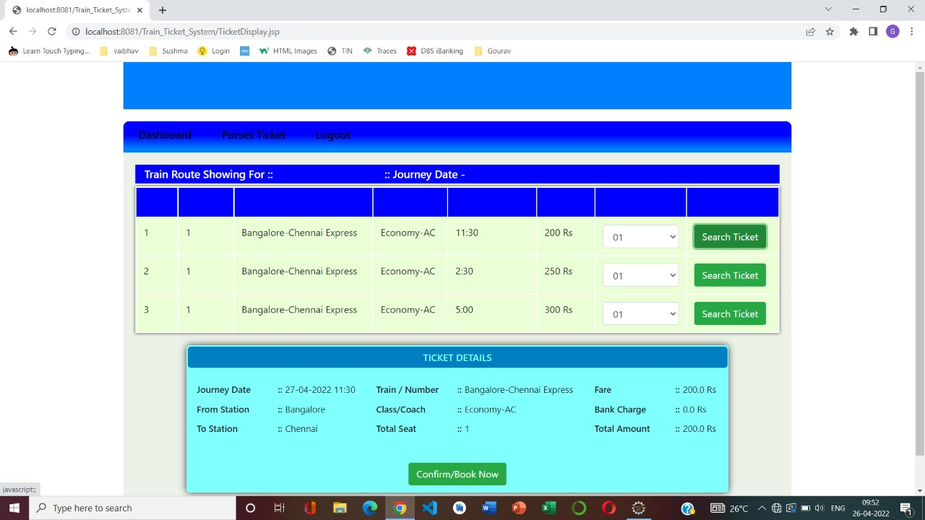
APPLICATION SCREENSHOTS

Slide 17
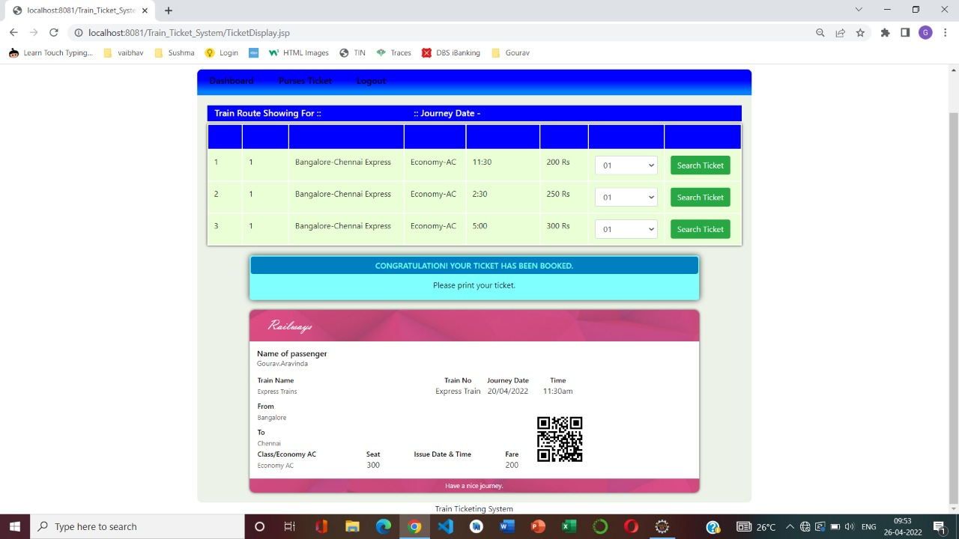
APPLICATION SCREENSHOTS

Slide 18
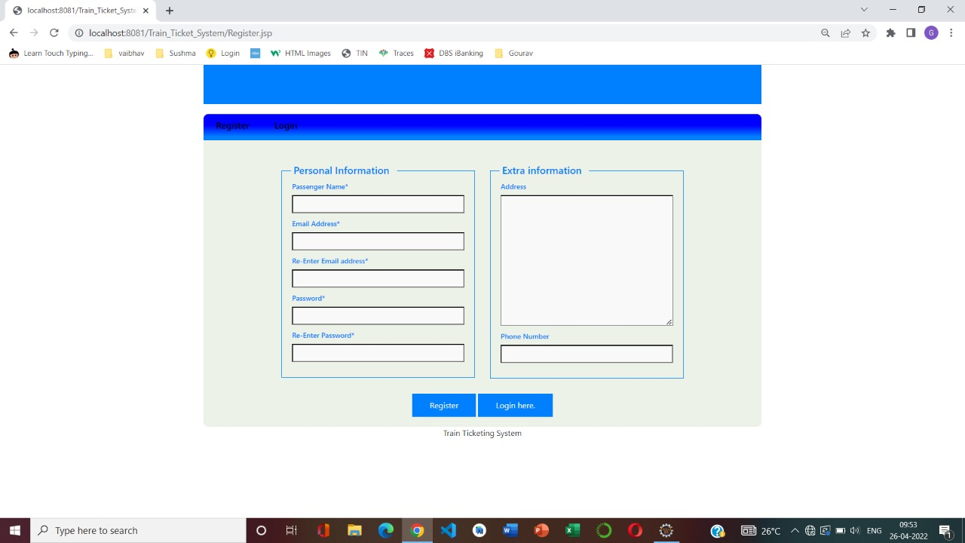
APPLICATION SCREENSHOTS

Slide 19
Team member contribution
SRN | Name | Contributions | Percentage
PES2UG19CS108 | DEV DARSHAN J | Train list, New destination, Create Stations, Station list | 33.334%
PES2UG19CS130 | GOURAV ARAVINDA | Seat reservation ,Purchase ticket , Display ticket, Find ticket | 33.333%
PES2UG19CS088 | BHARGHAV NARAYANAN | User Registration, login , Sign up, User verification | 33.333%

